Slide 1
KOKOsoko POC
Project code: KOS
Technical Design Doc

Slide 2
Summary
E-commerce platform running on the KP network.
The platform will utilise the web platform and run inside an Android webview on the KP Android App.
Payments will be done via Mpesa, exclusively.
Max quantity of 2 items per product can be purchased by customer in a session.
Max 1 product can be purchased by a customer in each session.
Targeted to specific KPs.

Slide 3
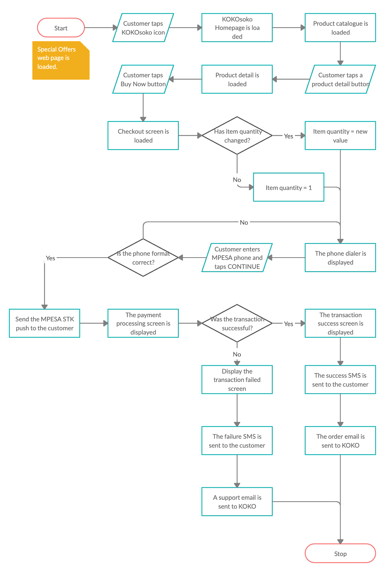
User Interaction Flow
Full Diagram Link

Slide 4
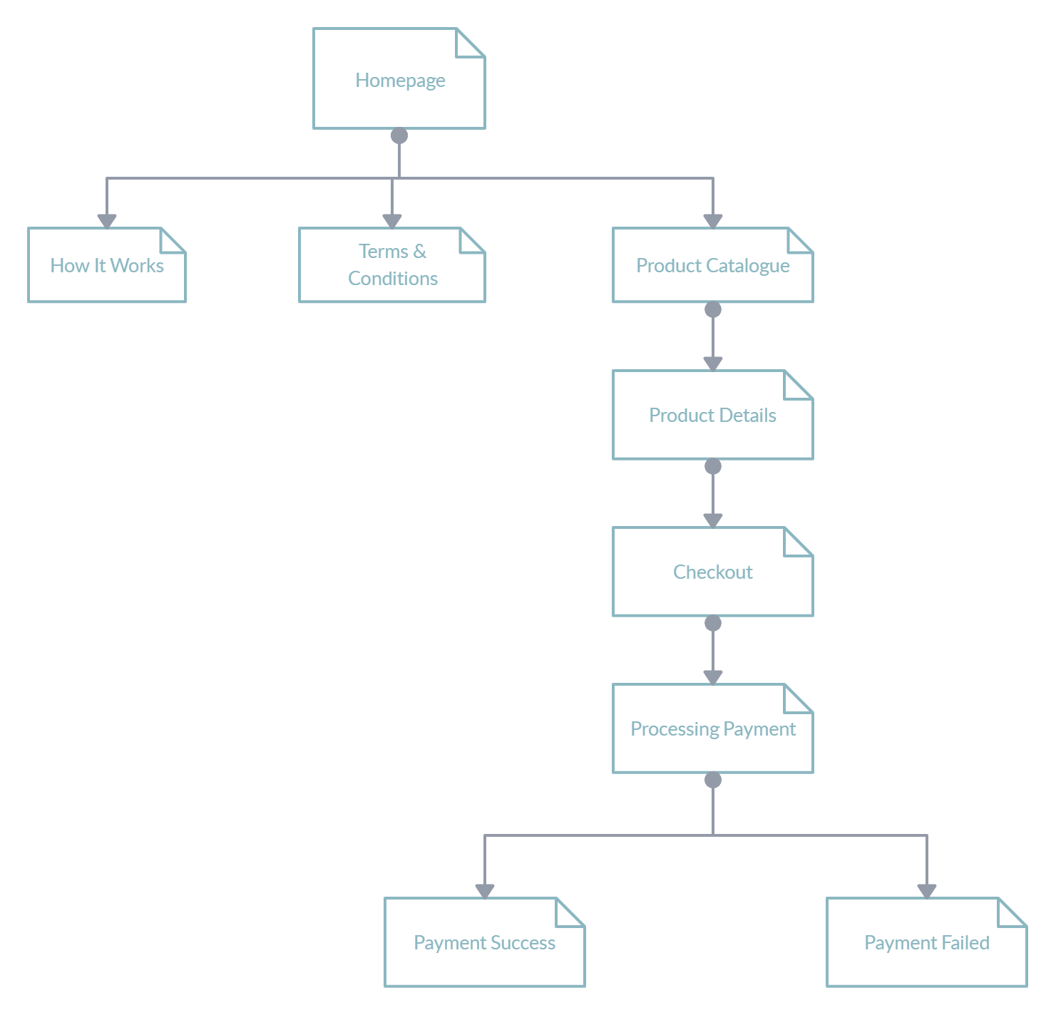
KOKOsoko App Sitemap (Components)
Full Diagram Link

Slide 5
KOKOSoko Ecosystem
Static Auth between KOKO Media and KOKOsoko
KP APP
KOKO MEDIA
KOKO SOKO
KOKO SOKO WEB APP
KOKO MEDIA CMS
SPECIAL OFFERS WEB PAGE
SPECIAL OFFERS SCREEN
SPECIAL OFFERS WEBVIEW
KOKO SOKO API
AD BUTLER (DAP)
KOKO SOKO DATABASE
Notes:
The KP app will only act as a browser and load a URL sending 3 pieces of info via the webview to the URL/web app.
KP Serial
Agent shop name
Agent neighbourhood
The KP is not expected to get anything back from the URL in terms of interactive data, all the interactions will happen in the web app itself

Slide 6
KP App Data Required
The KP app should be able to send 3 bits of data to the web application.
KP Serial
Agent shop name
Agent neighbourhood

Slide 7
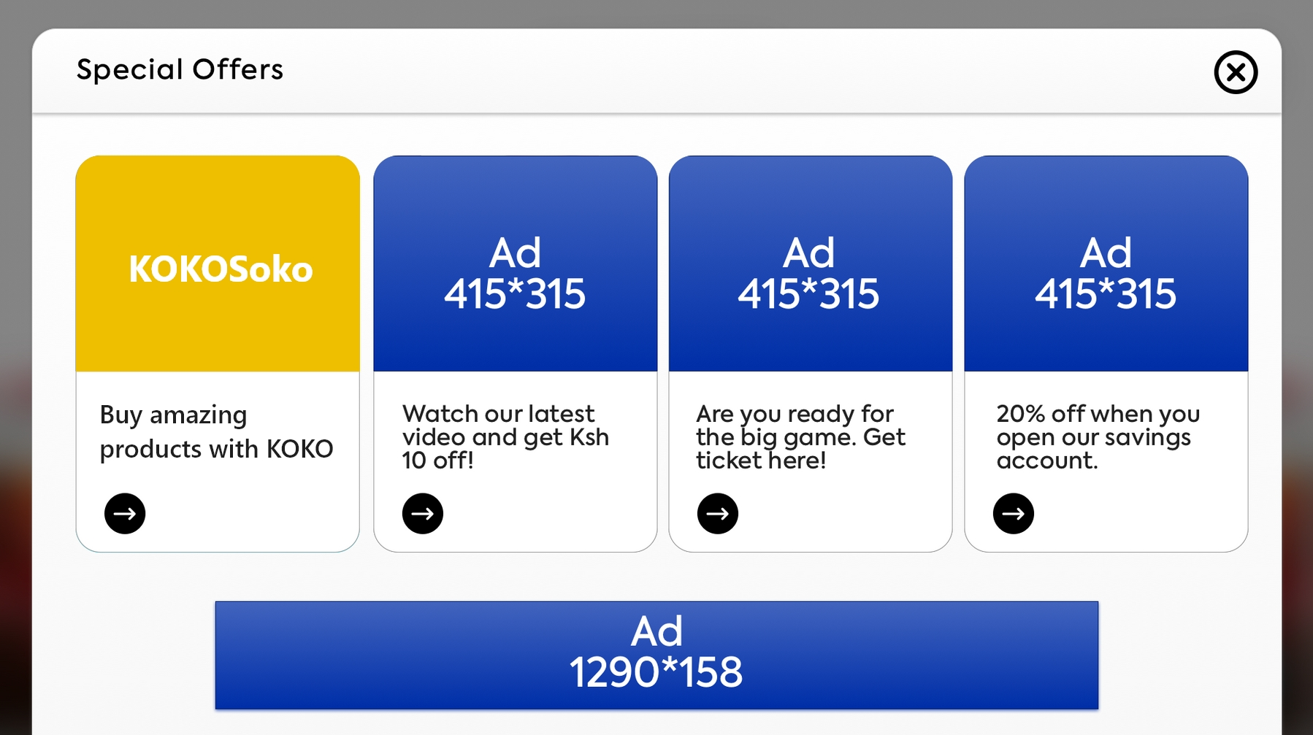
KP Special Offers Screen Loading (KP App)
KP app fetches the Special Offers page URL from KOKO Core using the Ad Zone tag.
KP app appends the KP ID and related variables to the Special Offers page URL as a URL variable.
KP app creates a webview component and loads the Special Offers web page in it.
START
STOP
TRIGGER: Tap the Special Offers button on the Home Screen
e.g. https://prod-media.kokodigitalmedia.com/special-offers
e.g. https://prod-media.kokodigitalmedia.com/special-offers?kp_serial=kpid_1234;shopname=Alpha;neighbourhood=Uthiru
Variables:
- KP Serial
- Shop Name
- Neighbourhood

Slide 8
KP Special Offers Page Loading (Webview)
Special Offers page appends the KP Serial to the Ad Zone tag of each app slot on the page as a keyword.
For each Ad Zone tag, Ad Butler matches the KP Serial for each Ad Zone and returns the appropriate results for display.
Special Offers page sends fetches the KP Serial and related variables from its URL..
START
2
TRIGGER: Load the Special Offers web page in the webview.
e.g.
kp_serial = ‘kpid_1234’
shopname = “Alpha Shop”
neighbourhood = “Uthiru”
e.g. https://servedbyadbutler.com/adserve/;ID=173609;size=0x0;setID=354256;type=json;keywords=kp_serial_1234;click=CLICK_MACRO_PLACEHOLDER
NB:
THIS ENABLES KP-LEVEL TARGETED APPS TO DISPLAY ONLY IN SELECTED KPS.
NON KP-LEVEL TARGETED APPS WILL DISPLAY ON ANY KP.

Slide 9
KP Special Offers Content (Apps) Loading
Special Offers page extracts the app url, icon url and description for each app slot from the Ad Butler result.
Special Offers page appends the KP info from the KP app to each app url for propagation into the apps.
2
3
{
“body”:””https://kokosoko.kokodigitalmedia.com”,
“image_url”: “https//:assets.kokodigitalmedia.com/appicons/kokosoko.png”,
“alt_text”: “Buy amazing products from KOKO Soko”
}
NB:
body = App url link
image_url = App icon url
alt_text = App description
e.g. https://kokosoko.kokodigitalmedia.com?kp_serial=1234;shop_name=Alpha Shop;neighourhood=Kawangware

Slide 10
KP Special Offers(SO) Content Loading
Special Offers page fetches the icon from the CDN (S3) and displays the icons, descriptions app links for opening the apps..
3
STOP

Slide 11
Order Object Data
Once an order has been placed the following payload will be sent to the CMS
The CMS will in term return an order number that will be used in the payment process
{
product_id: 1,
quantity: 1,
phone_number: ‘0712123456’,
kp_serial: ‘KP-0001’,
agent_name: ‘Some Awesome Shop’,
neighbourhood: ‘Pangani’,
order_date: ‘2020-04-01T13:46:03+03:00’
}
UTC Format

Slide 12
Payment Status Data
On successful order placement an order number will be returned by the CMS. The following payload will be sent on successful payment. The same payload will also be sent via email to the team.
In the event of a failed payment the payload will be sent via email to the team.
{
order_id: 1,
mpesa_transaction_code: ‘a1b2c3d4’,
payment_date: ‘2020-04-01T14:01:26+03:00’
}
UTC Format

Slide 13
KOKOsoko API Endpoints
API Endpoint | JSON Format | Description
/kos/products/ | [{ product_id: 1, product_name: 'kettle', product_description: 'A wireless kettle that can heat water for tea, coffee or just having a bath', product_price: 1000, product_image: 'https://kokosoko.com/products/kettle.jpg', product_competitor_price: 1200}, ...] | Returns and array of products that have the display set to true

Slide 14
KOKOsoko API Endpoints
API Endpoint | JSON Format | Description
/kos/products/all | [{ product_id: 1, product_name: 'kettle', product_description: 'A wireless kettle that can heat water for tea, coffee or just having a bath', product_price: 1000, product_image: 'https://kokosoko.com/products/kettle.jpg', product_competitor_price: 1200, display: false}, ...] | Returns and array of all products regardless of whether the display property is set to true or false

Slide 15
KOKOsoko API Endpoints
API Endpoint | JSON Format | Description
/kos/products/{id} | {product_id: {id}, product_name: 'kettle', product_description: 'A wireless kettle that can heat water for tea, coffee or just having a bath', product_price: 1000, product_image: 'https://kokosoko.com/products/kettle.jpg', product_competitor_price: 1200, display: false} | Returns a single product regardless of whether the display property is set to true or false

Slide 16
KOKOsoko API Endpoints
API Endpoint | JSON Format | Description
/kos/order/place { product_id: 1, quantity: 1, mpesa_number: ‘0712123456’, kp_serial: ‘KP-0001’, date: {date} } | { order_id: {id}} | Returns generated order ID

Slide 17
KOKOsoko API Endpoints
API Endpoint | JSON Format | Description
/kos/order/pay { order_id: {order_id}, mpesa_transaction_code: ‘a1b2c3d4’, payment_date: {date} } | Status code: 200 Status code: 500 | Payment successful Payment failed Payment failed will only occur after a timeout. If no response is received from Safaricom within a given time period

Slide 18
ER Diagram
kos_product
kos_order
payment
product_id (PK) int
product_name string
product_decription string
product_price float
product_image URL | string
product_competitor_price float
display_product boolean
order_id (PK) int
product_id (FK) int
phone_number string
kp_serial string
order_date date
order_id (FK) int
mpesa_transaction_code (PK) string
payment_date date

Slide 19
Communication Templates

Slide 20
Success Email - KOKO
A new order has come in from {kp-agent-name} based in {kp-neighbourhood}. An order for {product-name} x {product-quantity} which has been paid for with transaction ID {transaction-id} at {date-time}.
Summary below.
Order Number: {order-id}
Customer Phone Number: {customer-phone}
Agent Name: {kp-agent-name}
Neighourhood: {kp-neighbourhood}
Product: {product-name} x {product-quantity}
Mpesa Code: {transaction-id}
Date: {date-time}
Kindly process and dispatch as soon as possible.

Slide 21
Failed Email - KOKO
A customer attempted to create a new order but payment has failed, kindly reach out to them on the following details.
Summary below.
Order Number: {order-id}
Customer Phone Number: {customer-phone}
Agent Name: {kp-agent-name}
Neighourhood: {kp-neighbourhood}
Product Interested in: {product-name} x {product-quantity}
Date: {date-time}

Slide 22
Success SMS - Customer
Thank you for your purchase, your order number is {order-id} of {product-name} x {product-quantity} which will be dispatched to {agent-name} once its been processed.

Slide 23
Dispatched SMS - Customer
Congratulations your order number {order-id} of {product-name} x {product-quantity} can be picked up from {agent-name} at your convenience.

Slide 24
Failed SMS - Customer
Unfortunately your payment was not successful, a KOKO customer support agent will call you at {customer-phone} to assist.

Slide 25
d.rehal@kokonetworks.com

